Slide 1

GROUP-1
HOSPITAL MANAGEMENT SYSTEM

Slide 2
Team- 1
1. 2563863 Pendyala Akash 2. 2563097 Chaitra R Bhat 3. 2563740 Debasish Sahu 4.2563085 Pendhota Shyam Sunder 5. 2563314 Adhithyan Vadakke Ellathu 6. 2563968 Ashutosh Mishra 7. 2564028 Chintapulusu Bhanu Priya 8. 2563624 Meghana N 9. 2563155 Sidharth Shankar Sonu 10. 2564376 Yadla Raviteja

Slide 3
Hospital Management System
Hospital Management System is easy to use and eliminates errors caused by handwriting.
It provides all data in a single platform, hence enables Business Intelligence Module to provide valuable insights into hospital operations and the quality of patient care.
It enhances the overall health care experience in a healthcare facility.
It improves the communication and interaction of doctors with their patients.
It reduces expenses of an organization because of less paperwork, improved safety, and reduced duplication of testing.

Slide 4
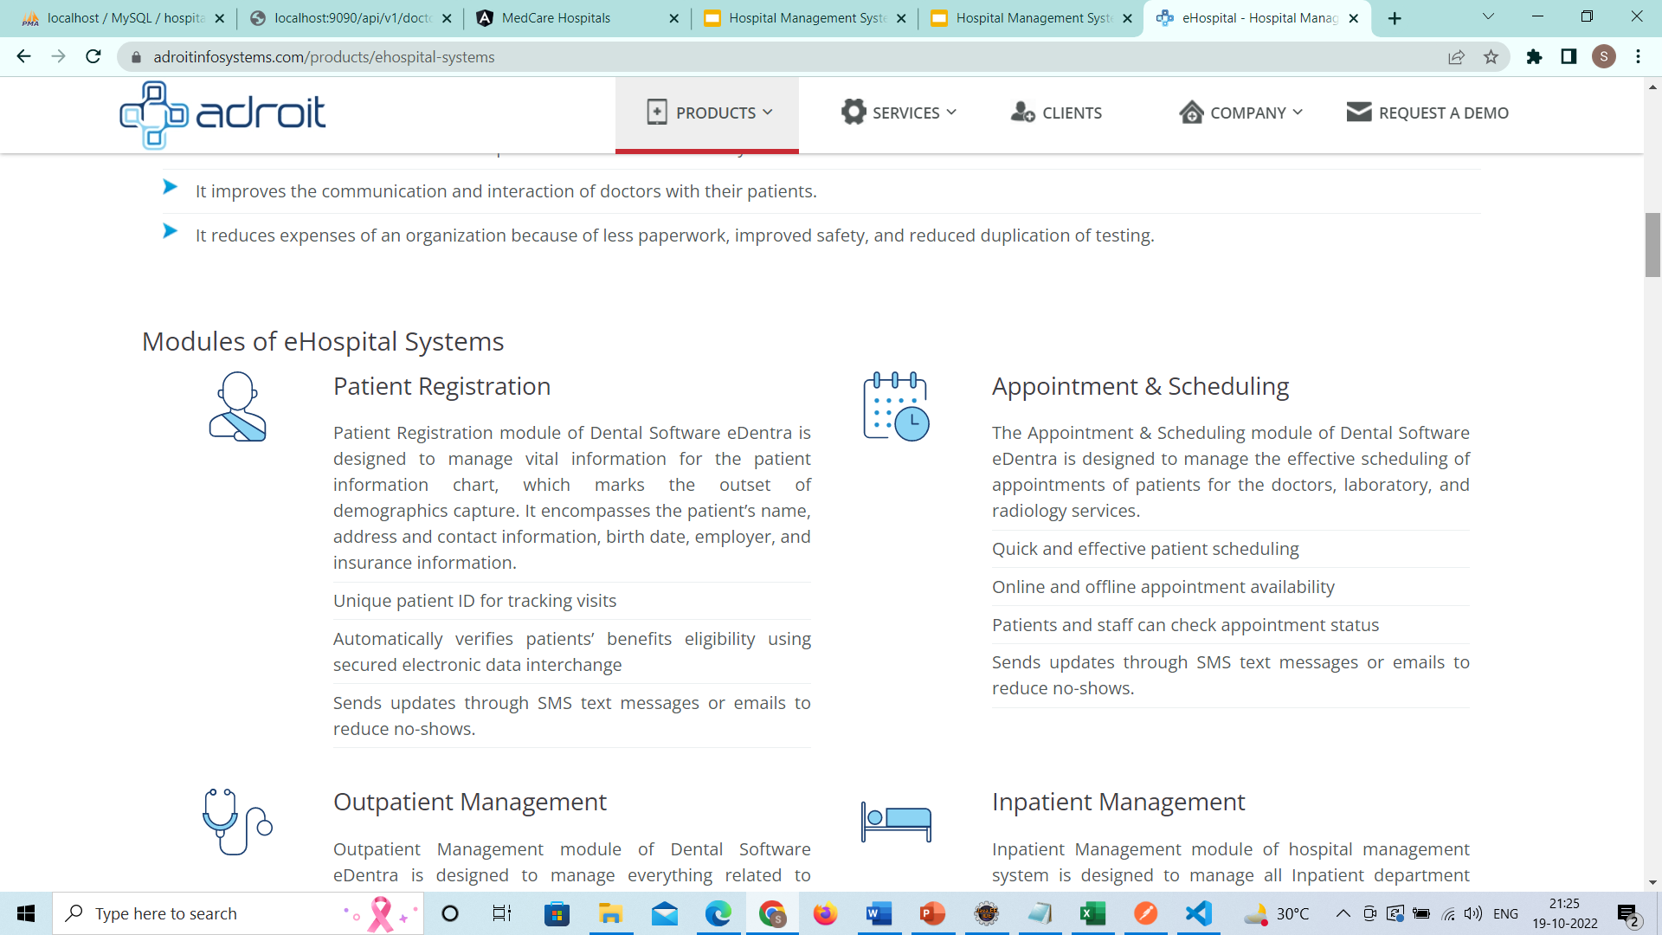
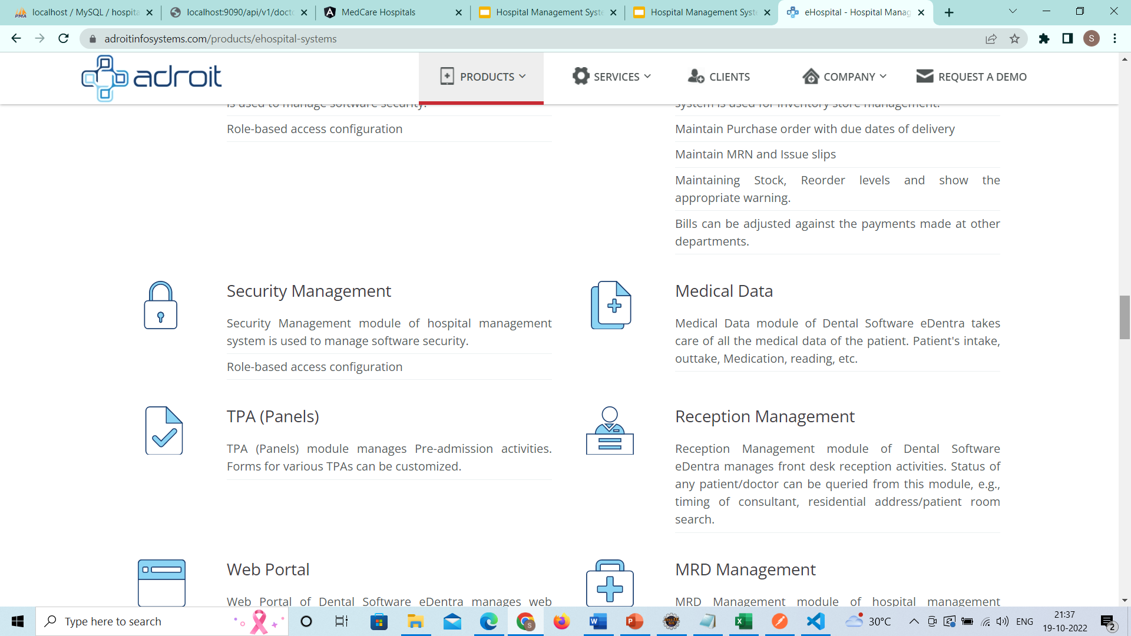
Features of MedCare Hospitals HMS
Patient Data Management
Doctor Data Management
Appointment
Booking
Administrative
Operations

Slide 5
Tools used for HMS
Spring cloud used for HMS
Springboot
Docker
postman
Config Server
Eureka Server
Feign
Resilience4j
Retry
Sleuth
Zipkin

Slide 6
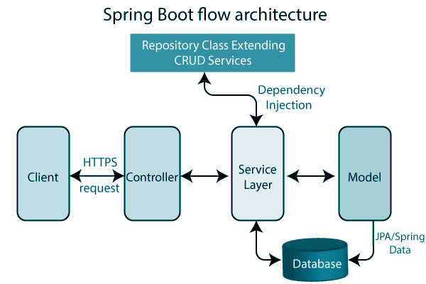
Spring Boot Architecture

Slide 7
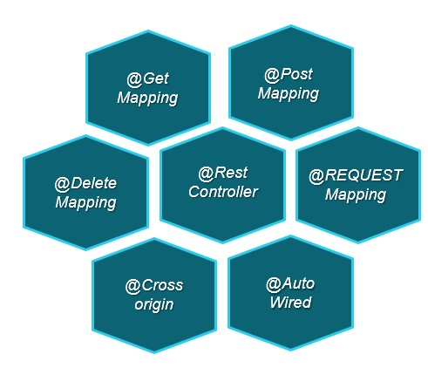
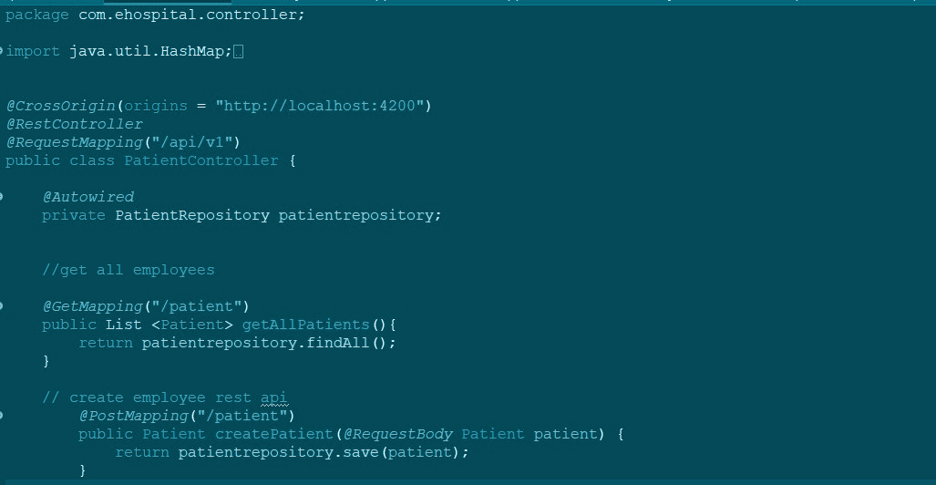
Controller Layer
The presentation layer consists of Views. the back-end part of the application and also It handles the HTTP requests.

Slide 8
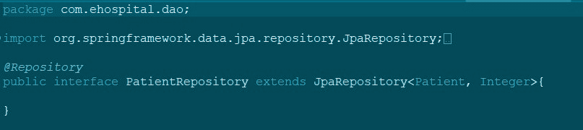
Service Layer
A service layer is a layer in an application that facilitates communication between the controller and the persistence layer.

Slide 9
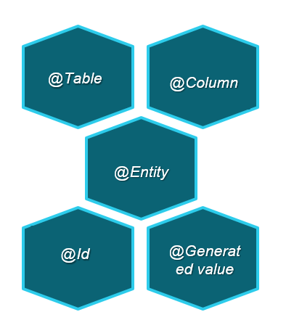
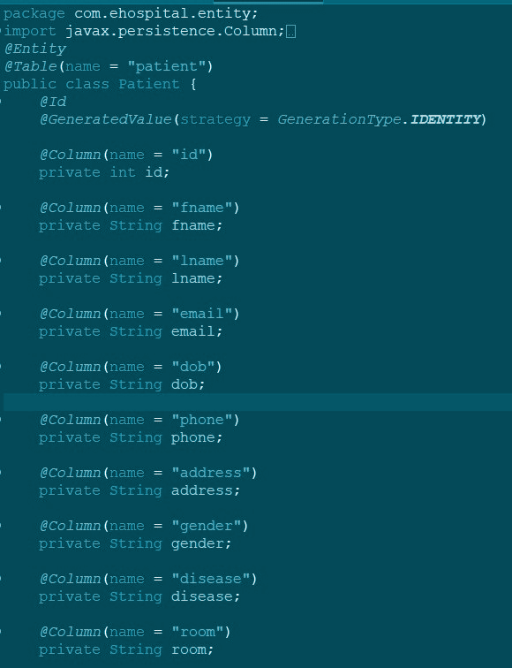
Model Layer
The persistence layer contains all the storage logic and translates business objects from and to database rows.

Slide 10
Spring cloud config
Spring Cloud Config provides server and client-side support for externalized configuration in a distributed system. With the Config Server you have a central place to manage external properties for applications across all environments.
The concepts on both client and server map identically to the Spring Environment and Property Source abstractions, so they fit very well with Spring applications, but can be used with any application running in any language.
As an application moves through the deployment pipeline from dev to test and into production you can manage the configuration between those environments and be certain that applications have everything they need to run when they migrate.

Slide 11
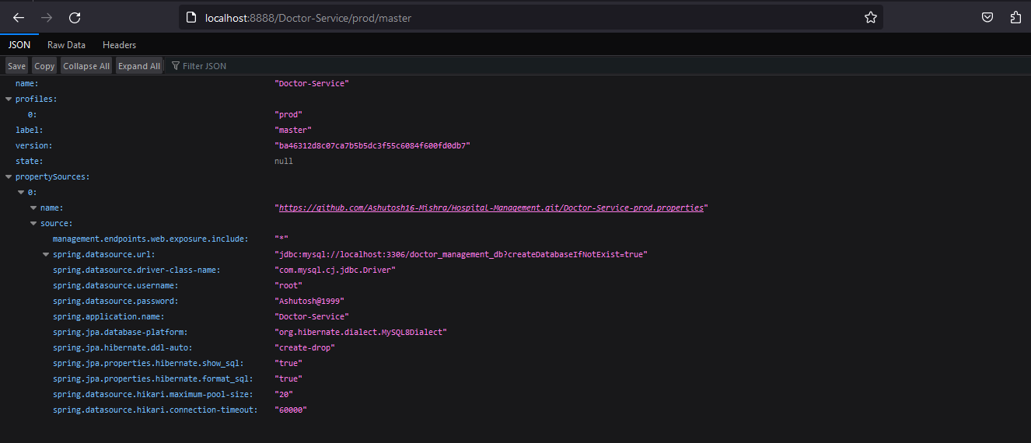

Slide 12
Eureka
Eureka is a REST (Representational State Transfer) based service that is primarily used in the AWS cloud for locating services for the purpose of load balancing and failover of middle-tier servers.

Slide 13
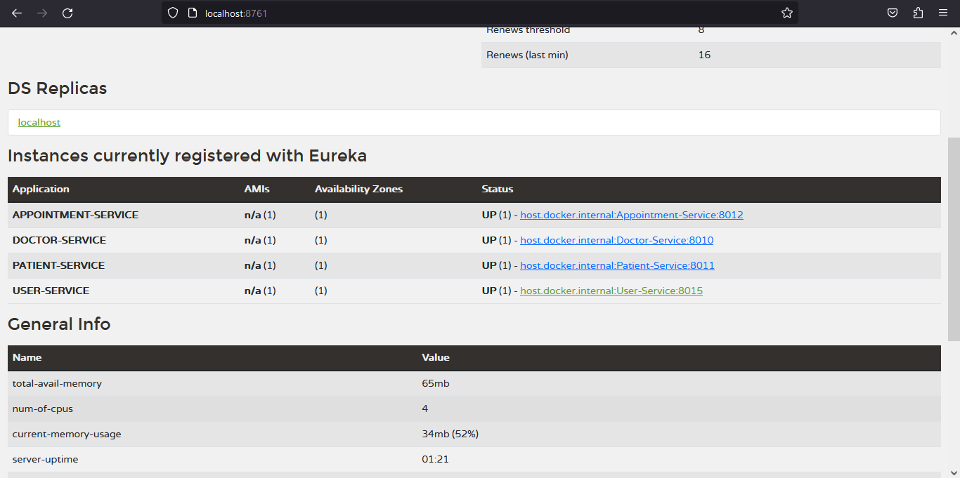
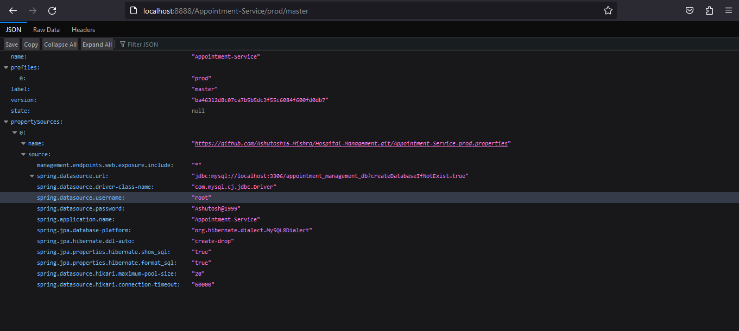

Slide 14
Feign client
Declarative REST Client
Integrates with Resilience4j = Circuit Breaker
Eureka = Service Discovery
Spring Cloud Starter
spring-cloud-starter-open-feign www.thoughts-on-java.org Feign Clients
@EnableFeignClient on configuration class
@FeignClient annotation on interface
Class implements fallback methods using Resilience4j

Slide 15
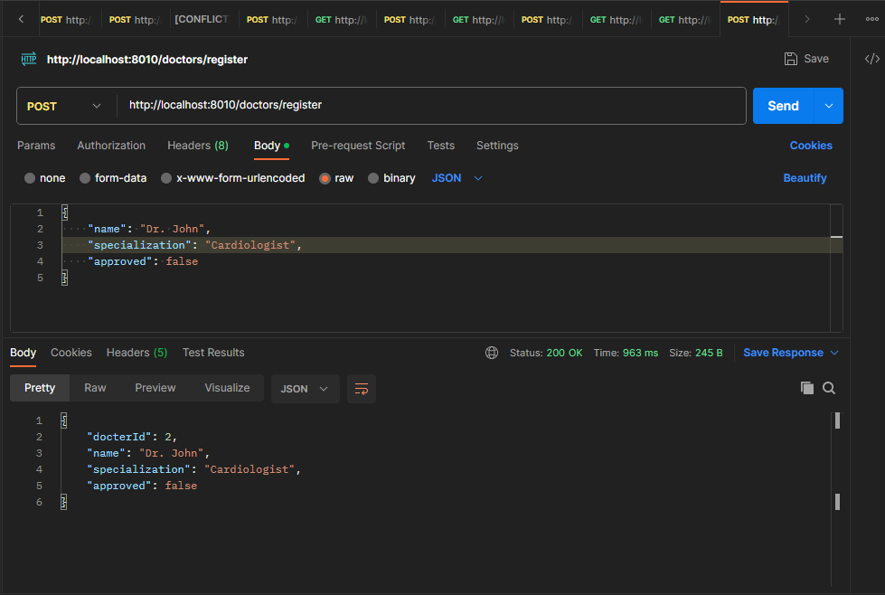

Slide 16
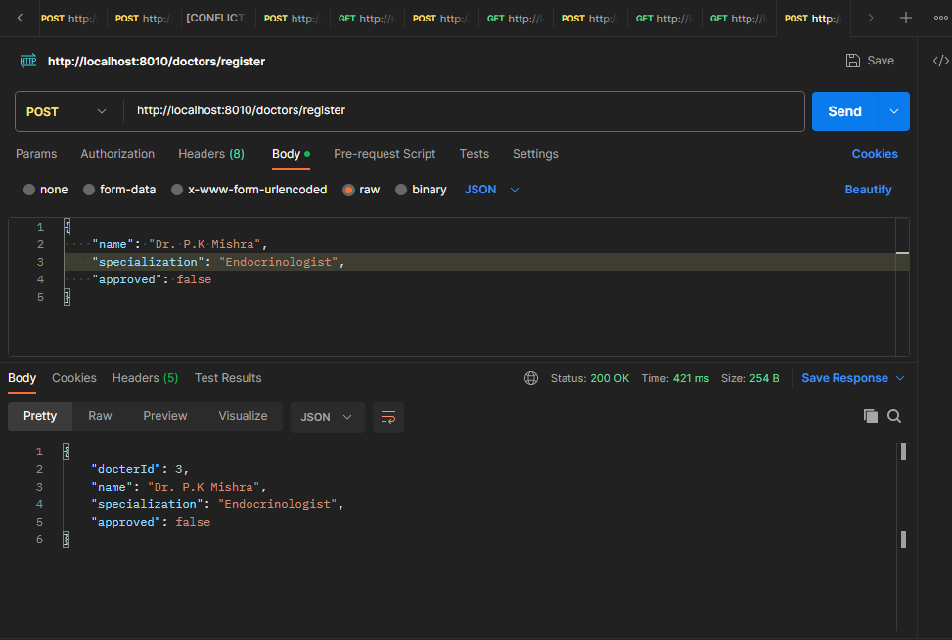

Slide 17
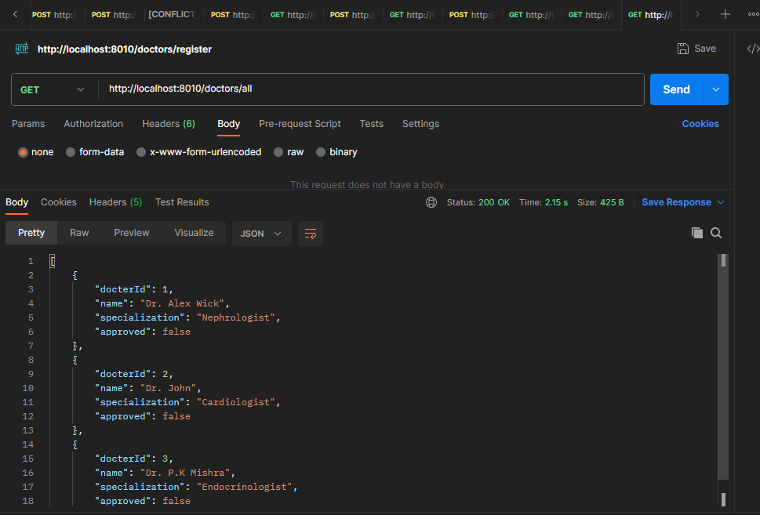
← Selector

Slide 18
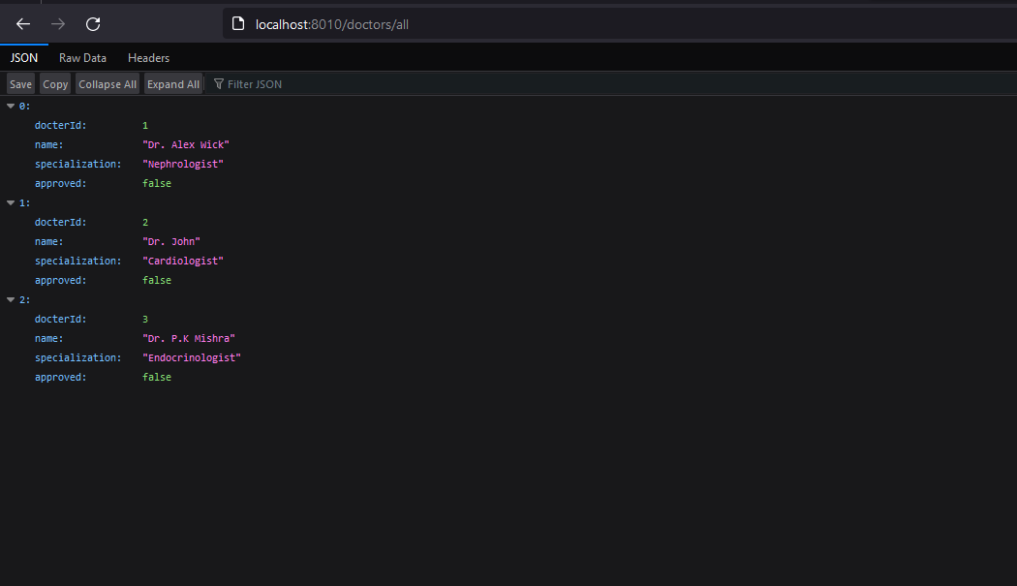

Slide 19
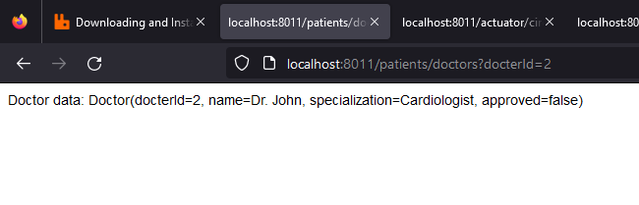

Slide 20
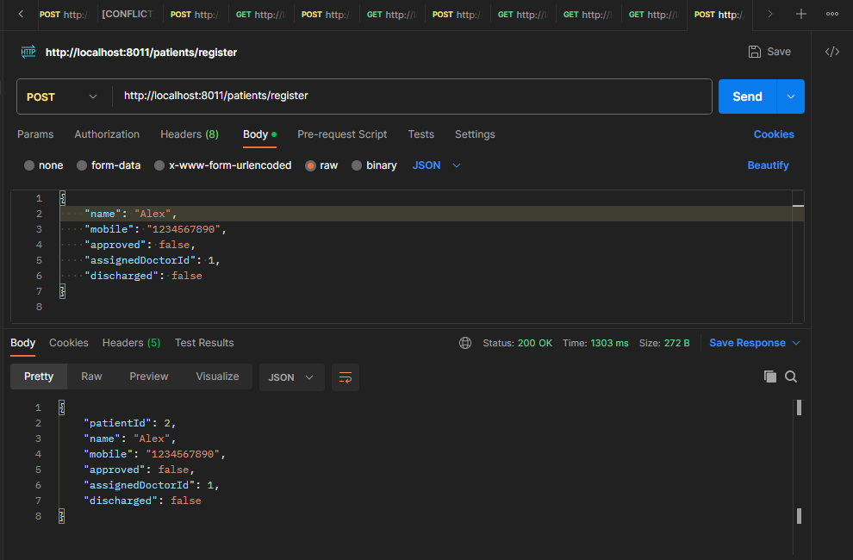

Slide 21
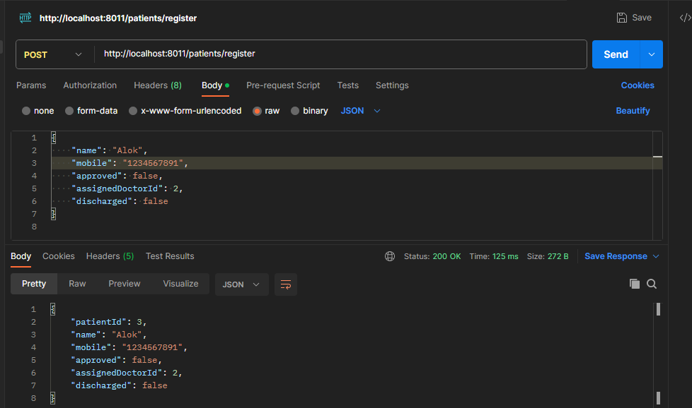

Slide 22
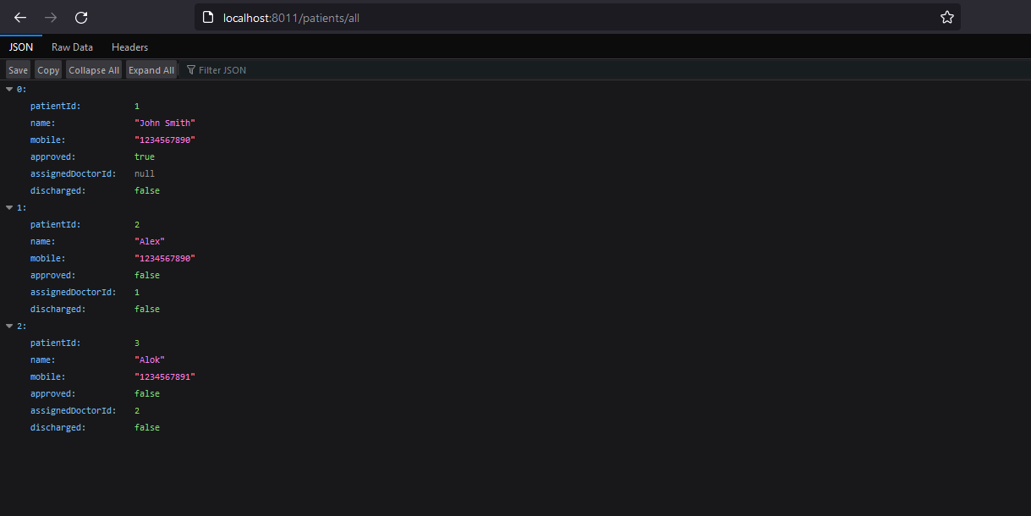

Slide 23
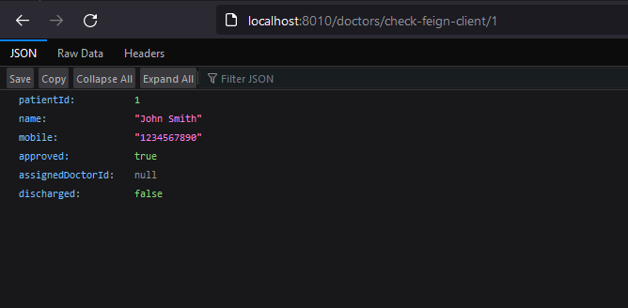

Slide 24
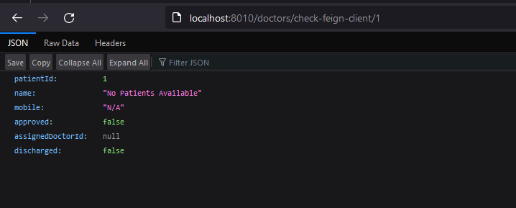

Slide 25
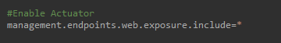
Actuator
Spring boot actuator provides production grade metrics, auditing, and monitoring features to your application.
Just adding the actuator dependency makes it available on our 8888 port.
Some of the key Actuator features include:-
Health - The health endpoint provides information about the application's health status. It can be used to check if the application is running smoothly or if there are any issues.
Environment - The environment endpoint provides information about the application's configuration, including properties and profiles

Slide 26
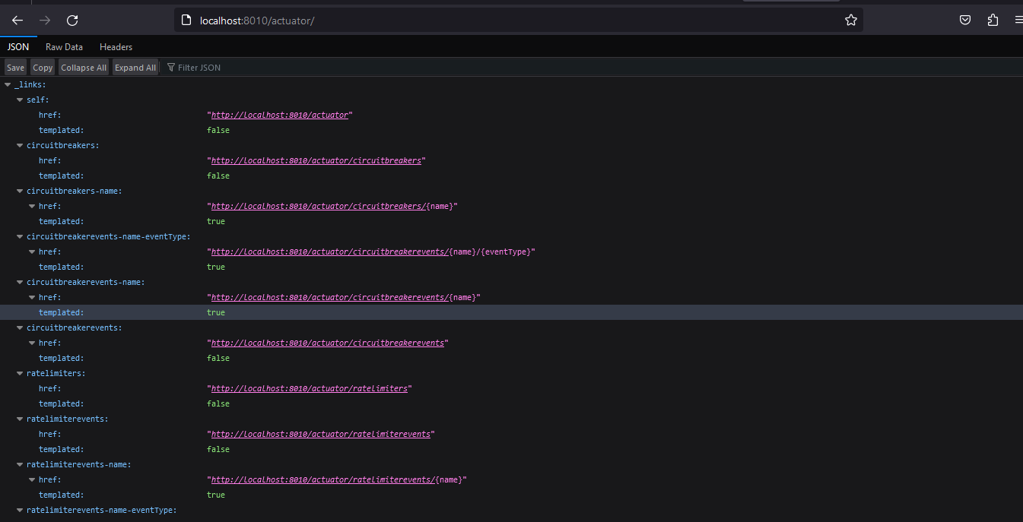

Slide 27
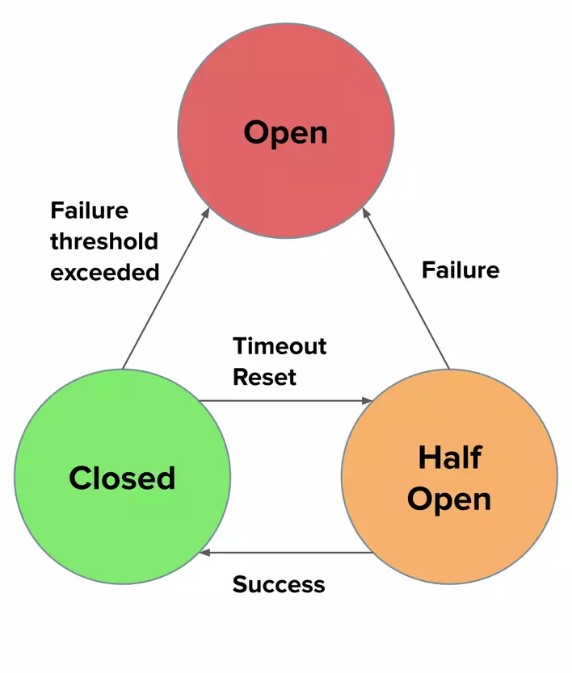
Circuit breaker
Protects from cascading failures
Fallback
Resilience4j
Failure threshold exceeded
Spring Retry
Pluggable Algorithm
Reactive support

Slide 28
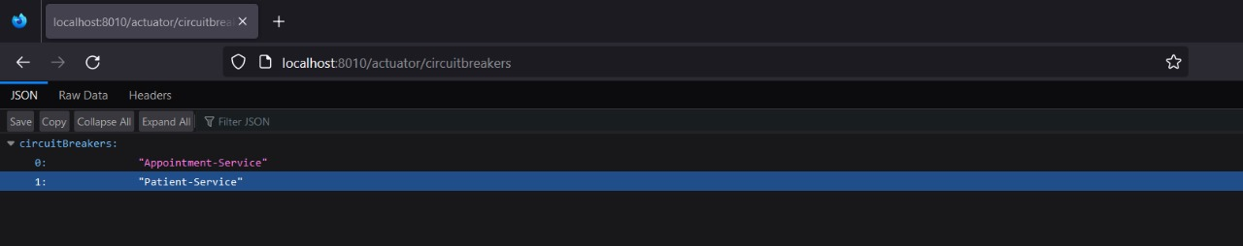

Slide 29
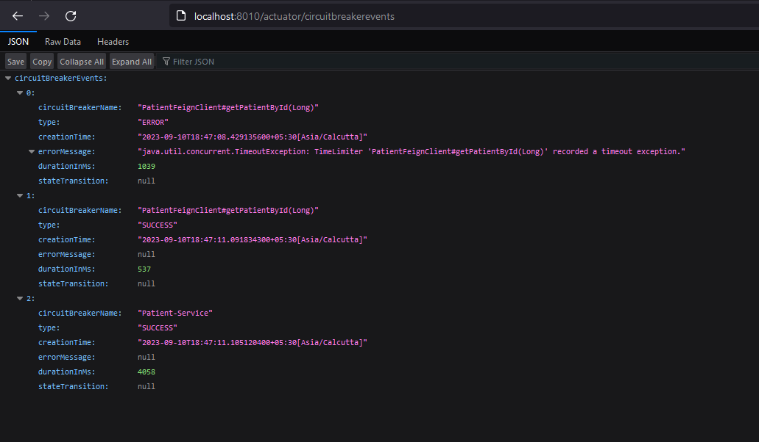

Slide 30
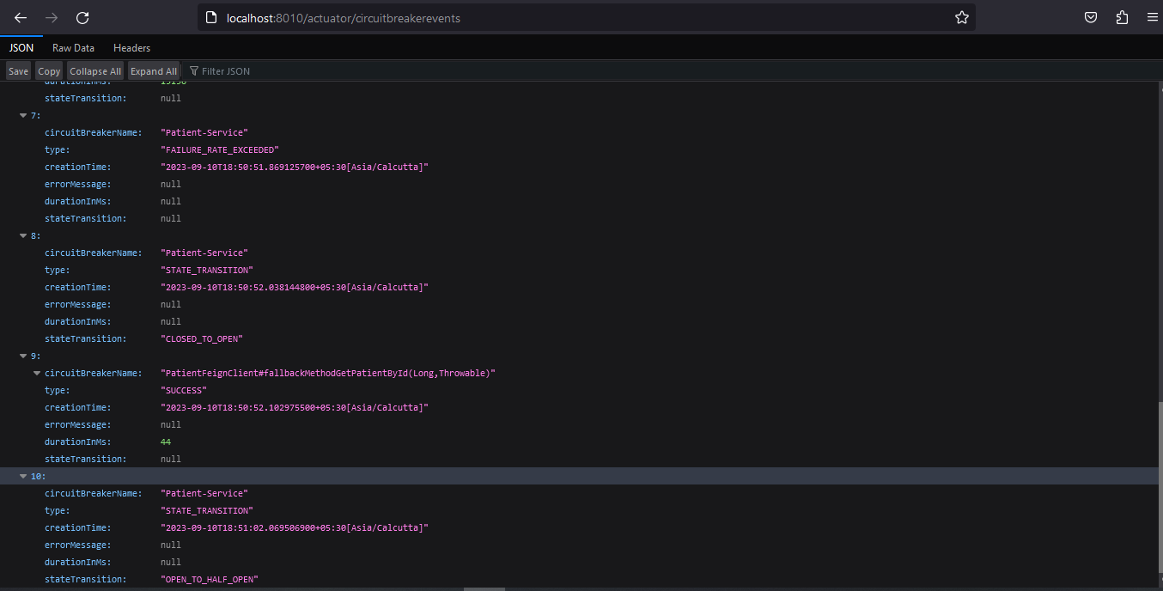

Slide 31
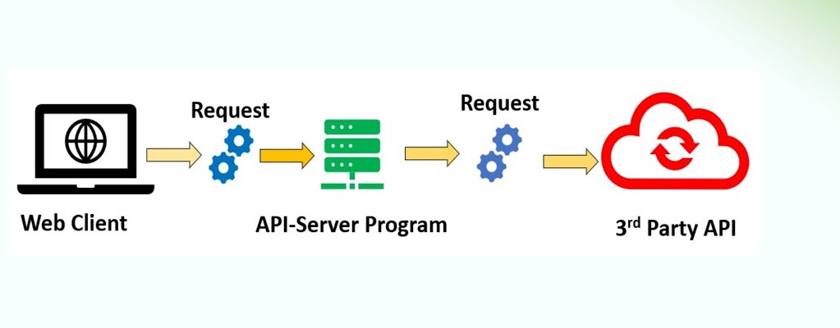
Retry

Slide 32
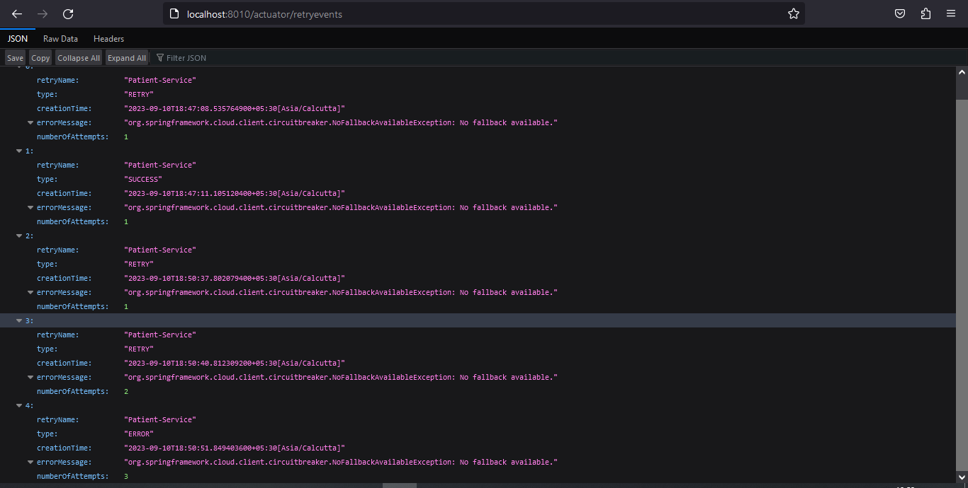

Slide 33
Sleuth & Zipkin

Slide 34
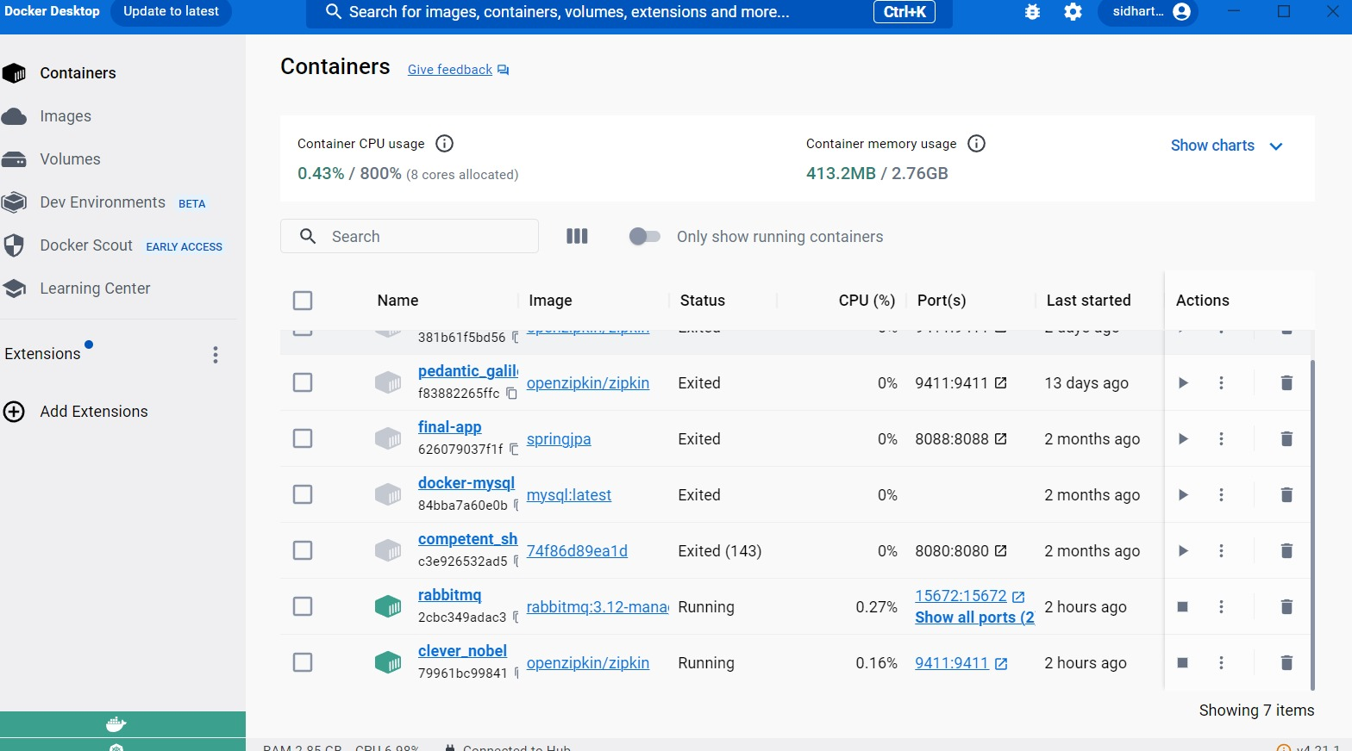

Slide 35
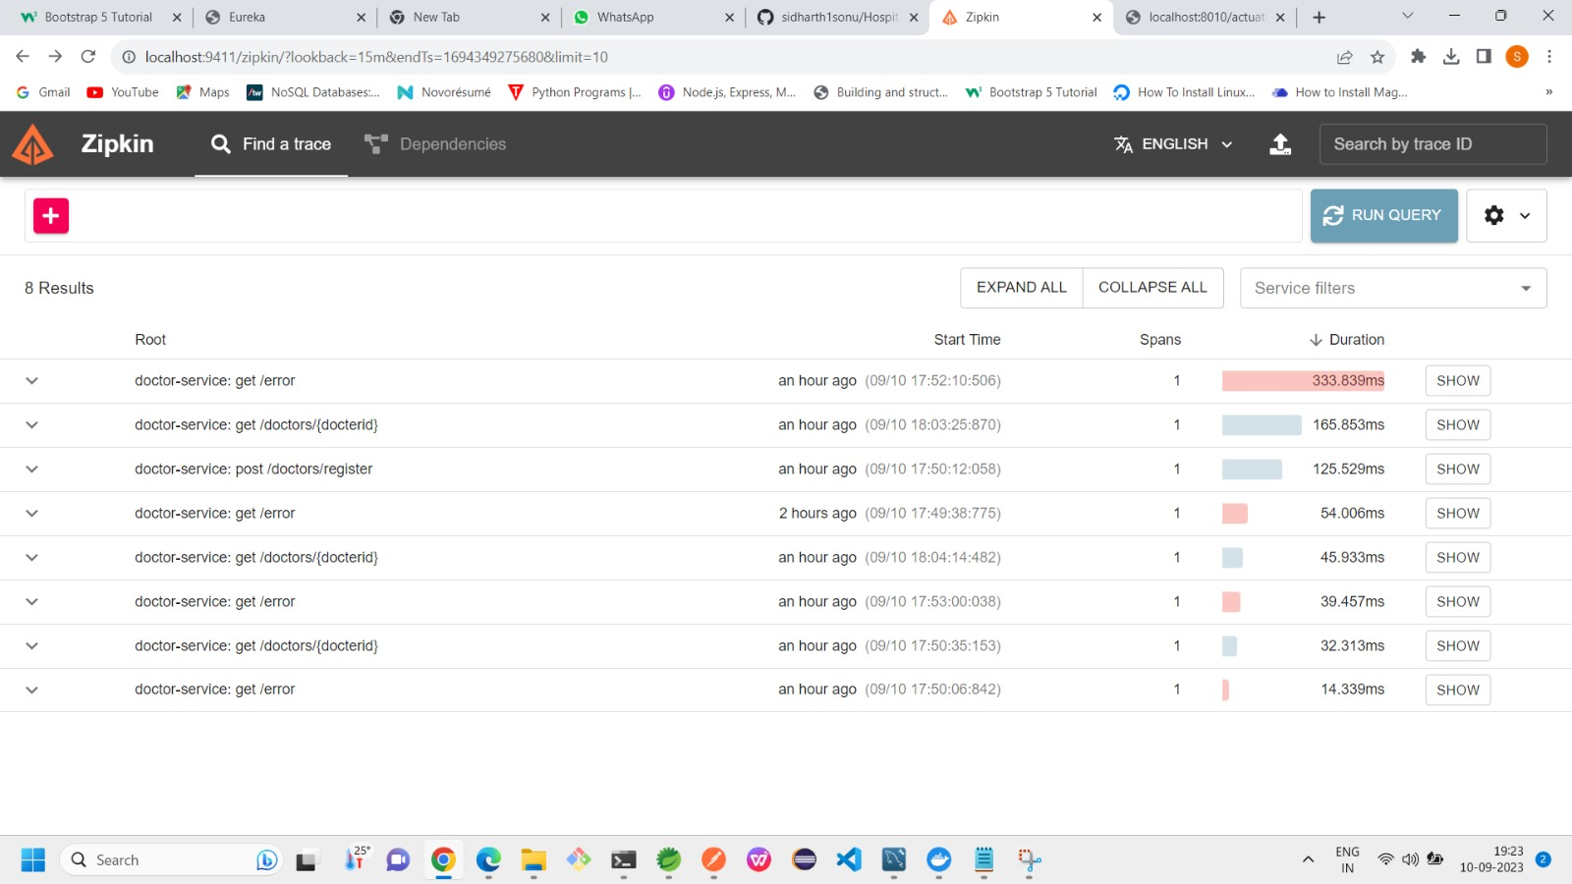

Slide 36
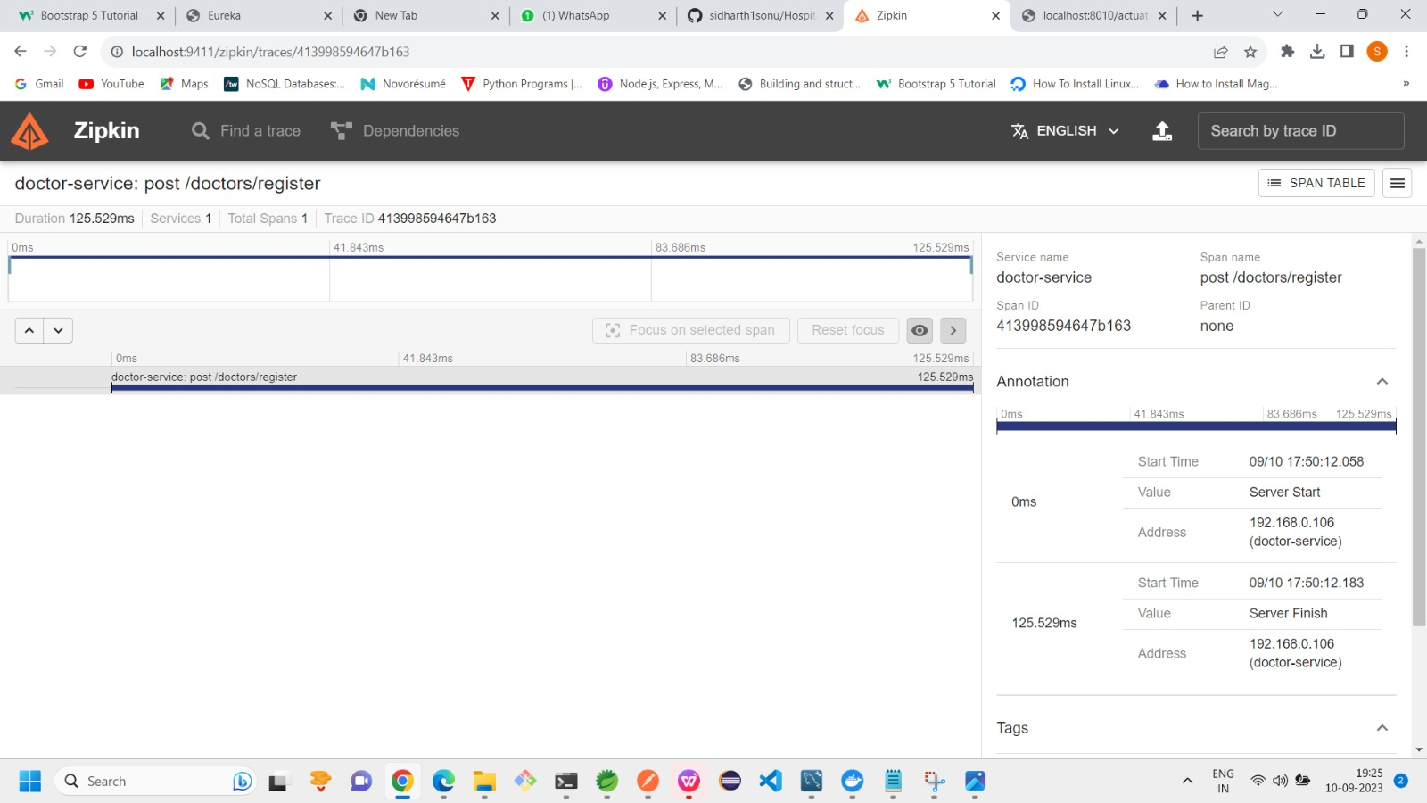

Slide 37


Advantage
Disadvantage
User friendly service
We can maintain the digital medical records
less time consumption
Patient self-service
Avoid errors and track every single details
It will affect the Employment of staffs working in administration

Slide 38

Conclusion
Hospital management systems allows us the ability to optimize and digitalize all the processes within the institution
It will help to improve customer service, reduce process costs, streamline the search of medical records, bills, patients, doctors, etc
Hospital Management System will contributed enormously to better health and influenced the lives and well-being of billions of humans

Slide 39
Future scope & Improvements
We will add security using Spring Security and Jwt Authentication on our Login and Sign up
Features such as availability of ambulance (24*7) , emergency room and blood groups in the hospital can be updated in our website for user knowledge
In future, we can improve the UI design and add more features

Slide 40


